Slide 1
Mack/Murphy Unchained
CLRS 2018 Anaheim CA Daniel Murphy Trinostics

Slide 2
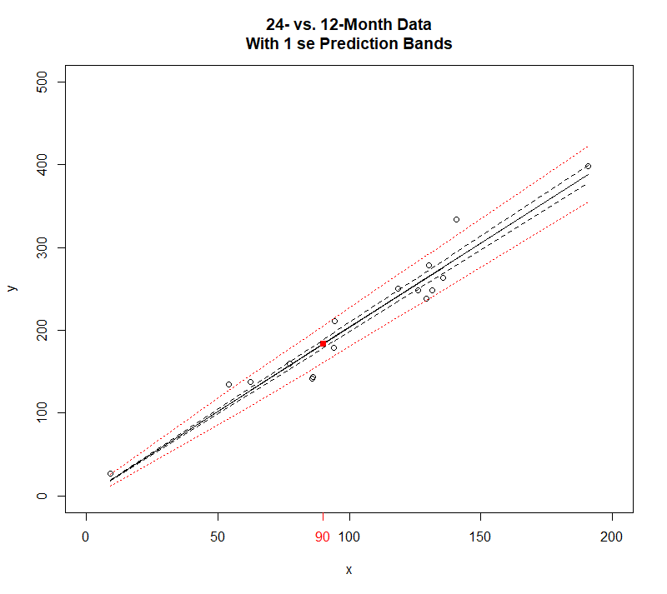
Illustration of Chainladder Procedure
The loss development method assumes a zero intercept

Slide 3
What kinds of situations are not captured by:
From the audience …

Slide 4
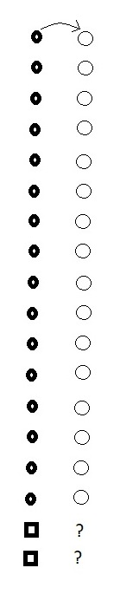

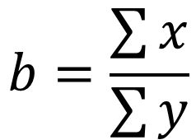
Chain-Ladder: First link
method
$$y=bx$$
We observe some objects that have changed over time
We observe two new objects
What is our estimate of their changed values?
traditional average link ratio
$$b=\frac{\sum{x}}{\sum{y}}$$

Slide 5

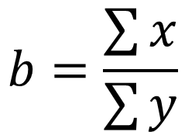




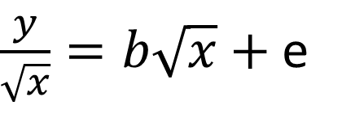

Chain-Ladder: First link
model
$$y=bx+ \sqrt{x}e$$
solves model
$$b=\frac{\sum{x}}{\sum{y}}$$
The traditional weighted average link ratio solves this model via MSE
Because it also solves the equivalent model
equivalent model
$$b={(X`X)}^{−1}X`Y$$
$\frac{y}{\sqrt{x}}=b\sqrt{x}+$e
$$or$$
$$minimizes$$
$$\sum{{\left(Y−bX\right)}^{2}}$$
$$Y=bX+e$$

Slide 6

Chain-Ladder: First link
Chain-Ladder: First link
Chain-Ladder: First link
Graph for this triangle
$$y=bx+ \sqrt{x}e$$

Slide 7
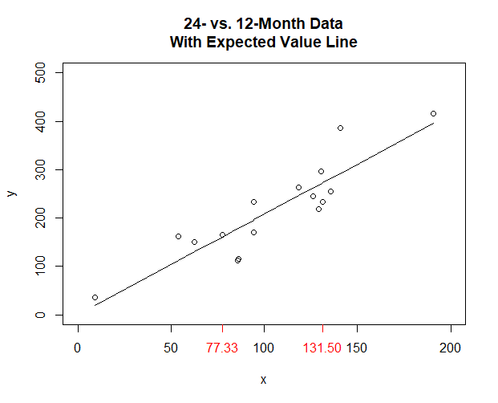

Development experience
slope of the line = 2.037 =
new points awaiting blastoff
$$\frac{\sum{x}}{\sum{y}}$$

Slide 8
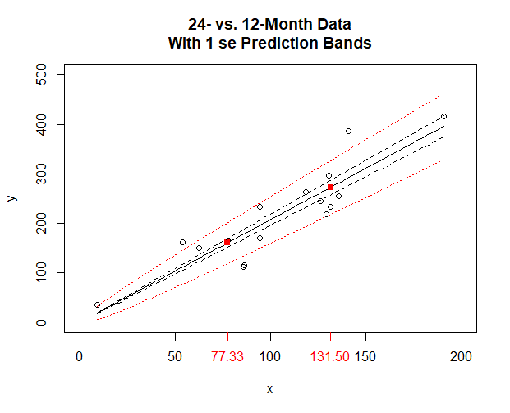
Predicted experience with “confidence levels”
--- parameter risk
total risk
Why does the prediction envelope fan out only at the high end?

